Slide 1
Saraiki Language Word Prediction and Spell Correction
Presenter:
Muhammad Farjad Ali Raza

Slide 2
Introduction
Many languages are spoken and written around the globe
In Pakistan, people speak and write in several languages
Saraiki is local language of Pakistan mostly spoken in South Punjab
Predicting missing words, finding similar words and spell correction are fundamental tasks of NLP
Embeddings of any language can be used to predict missing words and find similar words

Slide 3
Problem Statement
To the best of our knowledge no model has been trained for word prediction in Saraiki language
Dataset cannot be found online for Saraiki language
There is no spell correction method for Saraiki language

Slide 4
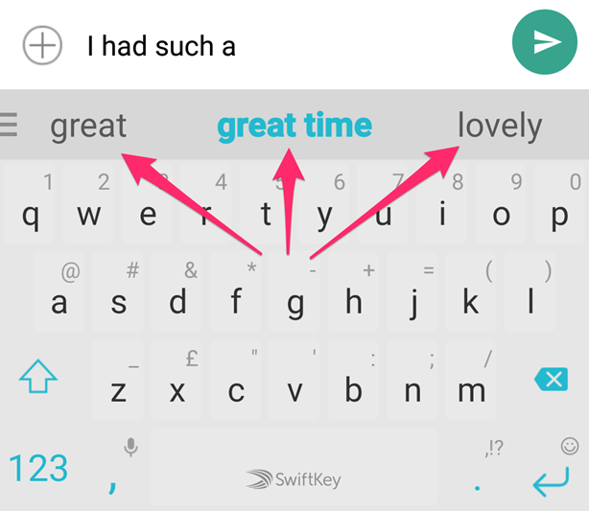
Motivation
Word prediction when typing text has been done for many languages we want to predict next word for Saraiki language
Notes:
Source: https://askubuntu.com/questions/1125541/word-prediction-like-android-keyboard

Slide 5
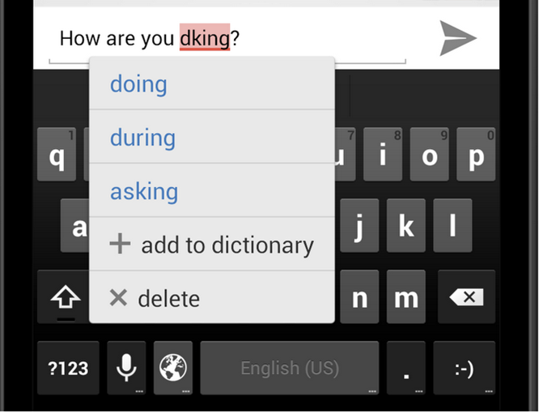
Motivation_{(cont)}
Spell correction is also important when typing text we want to correct spelling errors in Saraiki language
Notes:
Source: https://android-developers.googleblog.com/2012/08/creating-your-own-spelling-checker.html

Slide 6
Research Questions
Can we develop a model that can predict missing words in Saraiki language?
Can we find similar words by using model in Saraiki language?
Can we modify existing spell correction techniques for Saraiki language?

Slide 7
Research Contribution
Generating corpus for Saraiki language
Preprocessing raw dataset
Predicting missing words in a sentence
Finding similar words
Correcting spelling errors
Performance evaluation

Slide 8
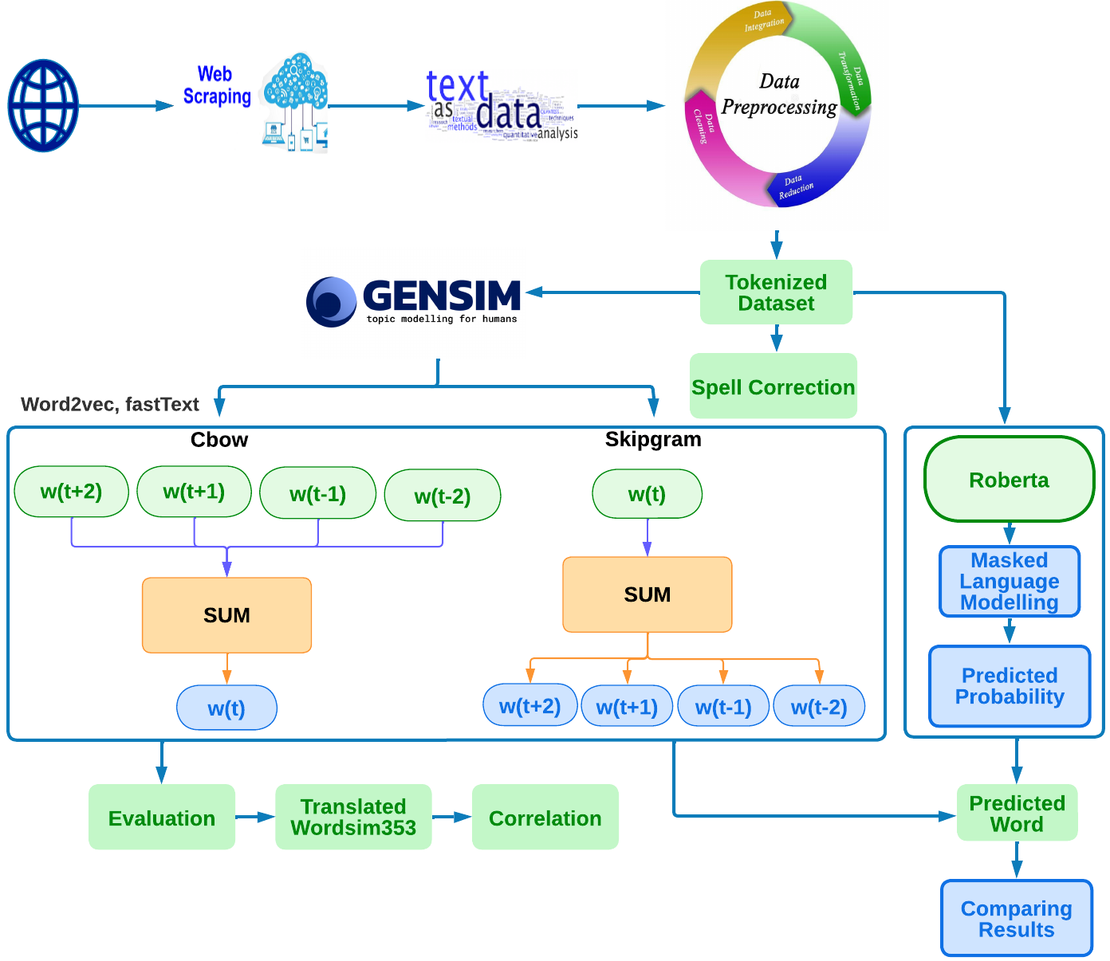
Methodology

Slide 9
Dataset
Scrapped from online websites
Wikipedia dumps are used
Combination of urduhack and regex operation are used to clean and filter dataset
Spacy is used for sentence and word tokenization

Slide 10
Preprocessing Dataset
Words like وہم و گمان (wehm o gumaan) containing و are separated in tokenization
Joiner and non joiner character problem
One way is using zero width space
Other is adding underscore instead of space
Emoticons, emails, numbers special characters are removed

Slide 11
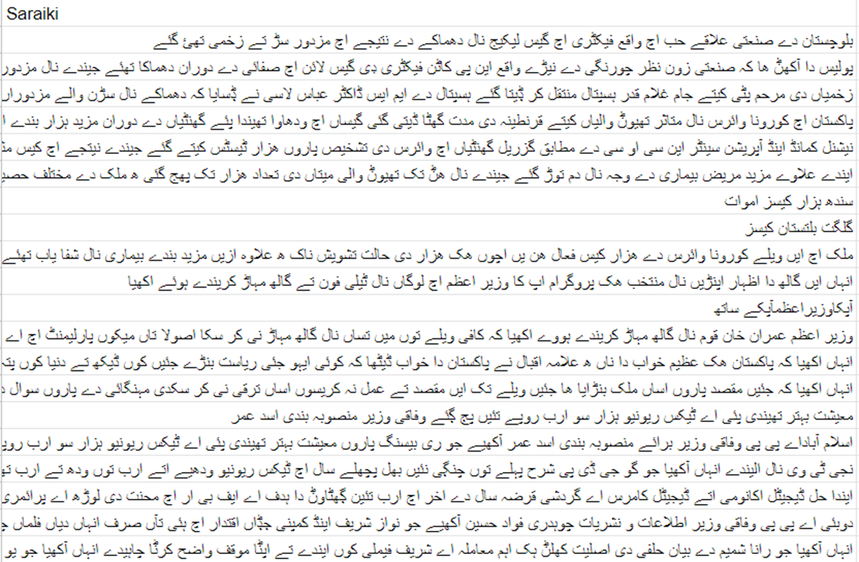
Dataset After Preprocessing

Slide 12
Experimental Setup
Word2vec and fastText:
Trained for 100 epochs
Min word count 1
Different vector sizes and window sizes
RoBERTa Model:
Tokenizer trained with new tokens and
Vocabulary size set to equal to the tokenized words
Train size 80% and test size 20%
Masked language modelling probability is set 15%
Save steps are set to 10000
Trained for 8 epochs

Slide 13
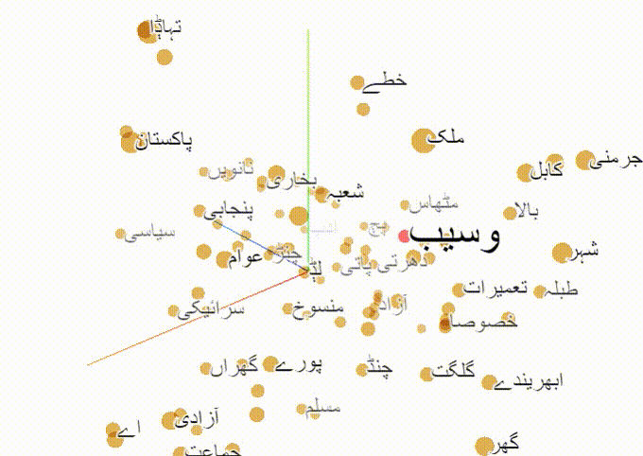
Semantic Space Similarity

Slide 14
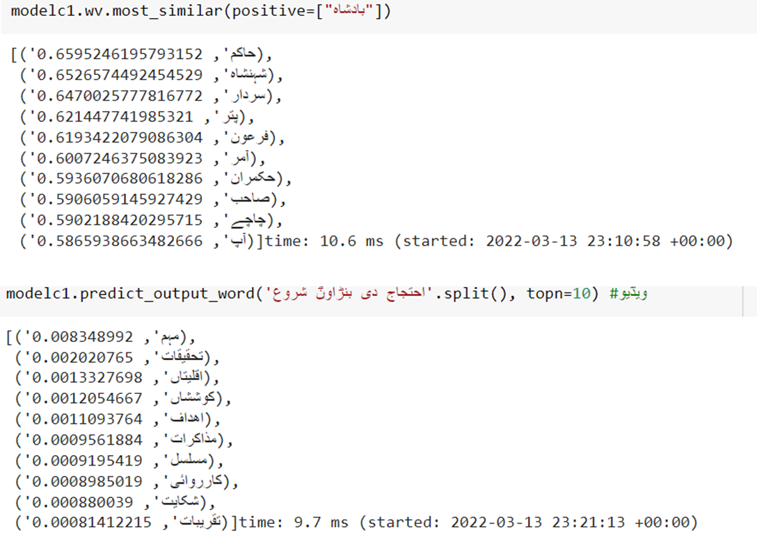
Word2vec Results

Slide 15
Word2vec Similarity Results (CBOW)
Window Size | WordSim-353
 | Vector Dimensions
 | 50 | 100 | 200 | 300 | 400 | 768
2 | 0.303 | 0.311 | 0.320 | 0.304 | 0.304 | 0.297
3 | 0.350 | 0.357 | 0.315 | 0.325 | 0.271 | 0.326
4 | 0.292 | 0.264 | 0.285 | 0.274 | 0.272 | 0.323
5 | 0.311 | 0.285 | 0.259 | 0.266 | 0.276 | 0.310
6 | 0.258 | 0.238 | 0.255 | 0.274 | 0.314 | 0.307

Slide 16
Word2vec Similarity Results (Skipgram)
Window Size | WordSim-353
 | Vector Dimensions
 | 50 | 100 | 200 | 300 | 400 | 768
2 | 0.321 | 0.350 | 0.336 | 0.325 | 0.322 | 0.298
3 | 0.339 | 0.372 | 0.344 | 0.325 | 0.288 | 0.306
4 | 0.337 | 0.320 | 0.317 | 0.297 | 0.289 | 0.316
5 | 0.357 | 0.324 | 0.356 | 0.327 | 0.311 | 0.313
6 | 0.392 | 0.342 | 0.337 | 0.330 | 0.336 | 0.313

Slide 17
Word2vec Word Prediction Accuracy
Window Size | WordSim-353
 | Vector Dimensions
 | 50 | 100 | 200 | 300 | 400 | 768
2 | 0.16 | 0.175 | 0.195 | 0.205 | 0.215 | 0.205
3 | 0.115 | 0.165 | 0.145 | 0.165 | 0.245 | 0.16
4 | 0.135 | 0.185 | 0.16 | 0.165 | 0.155 | 0.155
5 | 0.115 | 0.155 | 0.14 | 0.145 | 0.145 | 0.115
6 | 0.115 | 0.13 | 0.13 | 0.14 | 0.12 | 0.12

Slide 18
FastText Similarity Results (CBOW)
Window Size | WordSim-353
 | Vector Dimensions
 | 50 | 100 | 200 | 300 | 400 | 768
2 | 0.315 | 0.328 | 0.322 | 0.328 | 0.336 | 0.334
3 | 0.313 | 0.315 | 0.342 | 0.313 | 0.315 | 0.338
4 | 0.339 | 0.305 | 0.326 | 0.333 | 0.326 | 0.333
5 | 0.315 | 0.308 | 0.31 | 0.32 | 0.332 | 0.344
6 | 0.302 | 0.325 | 0.35 | 0.332 | 0.358 | 0.344

Slide 19
Fasttext Similarity Results (Skipgram)
Window Size | WordSim-353
 | Vector Dimensions
 | 50 | 100 | 200 | 300 | 400 | 768
2 | 0.374 | 0.363 | 0.358 | 0.368 | 0.337 | 0.335
3 | 0.393 | 0.417 | 0.377 | 0.342 | 0.322 | 0.331
4 | 0.387 | 0.353 | 0.38 | 0.348 | 0.338 | 0.338
5 | 0.4 | 0.371 | 0.365 | 0.351 | 0.344 | 0.332
6 | 0.4 | 0.354 | 0.353 | 0.338 | 0.38 | 0.338

Slide 20
Fasttext Word Prediction Accuracy
Window Size | WordSim-353
 | Vector Dimensions
 | 50 | 100 | 200 | 300 | 400 | 768
2 | 0.095 | 0.11 | 0.165 | 0.175 | 0.185 | 0.185
3 | 0.085 | 0.1 | 0.115 | 0.21 | 0.295 | 0.16
4 | 0.205 | 0.23 | 0.245 | 0.25 | 0.265 | 0.14
5 | 0.14 | 0.235 | 0.25 | 0.26 | 0.24 | 0.135
6 | 0.15 | 0.2 | 0.245 | 0.245 | 0.115 | 0.12

Slide 21
Highest Similarity
Model | Window Size | Vector Size | Similarity
Word2vec CBoW | 3 | 100 | 0.357
Word2vec Skipgram | 6 | 50 | 0.392
Fasttext Cbow | 6 | 400 | 0.358
Fasttext Skipgram | 3 | 100 | 0.417

Slide 22
Highest Accuracy On Word Prediction
Model | Window Size | Vector Size | Accuracy
Word2vec | 3 | 400 | 0.245
Fasttext | 3 | 400 | 0.295

Slide 23
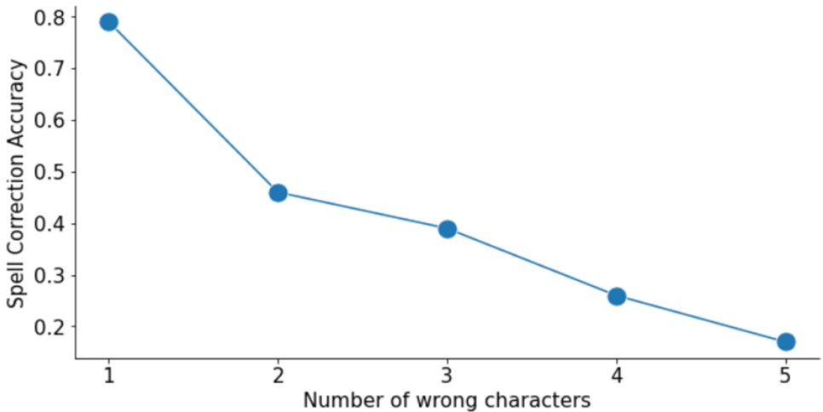
Spell Correction and Levenshtein Distance Results
Word Error | L.D Accuracy
1 | 0.79
2 | 0.46
3 | 0.39
4 | 0.26
5 | 0.17

Slide 24
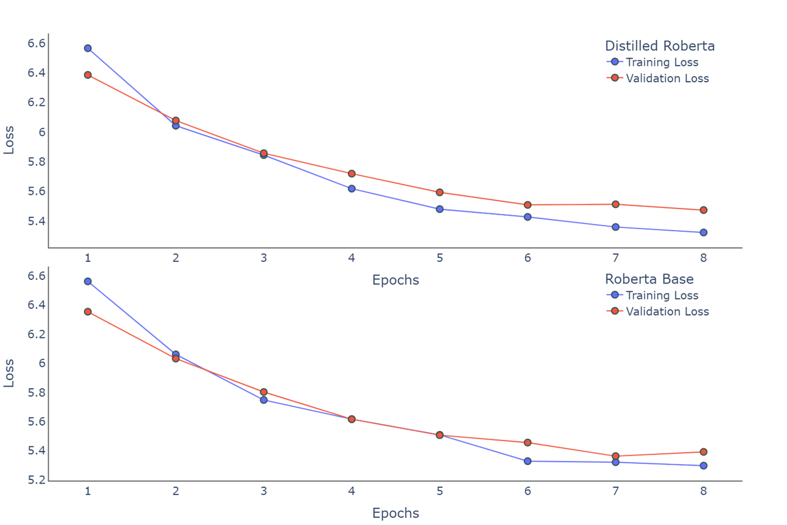
RoBERTa Training and Validation Loss

Slide 25
RoBERTa Base
Epoch | 1 | 2 | 3 | 4 | 5 | 6 | 7 | 8
Training Loss | 6.562 | 6.060 | 5.748 | 5.616 | 5.508 | 5.328 | 5.321 | 5.297
Validation Loss | 6.364 | 6.032 | 5.802 | 5.616 | 5.506 | 5.455 | 5.362 | 5.392

Slide 26
RoBERTa Distilled
Epoch | 1 | 2 | 3 | 4 | 5 | 6 | 7 | 8
Training Loss | 6.566 | 6.043 | 5.845 | 5.618 | 5.480 | 5.427 | 5.359 | 5.322
Validation Loss | 6.386 | 6.078 | 5.857 | 5.719 | 5.593 | 5.508 | 5.512 | 5.473

Slide 27
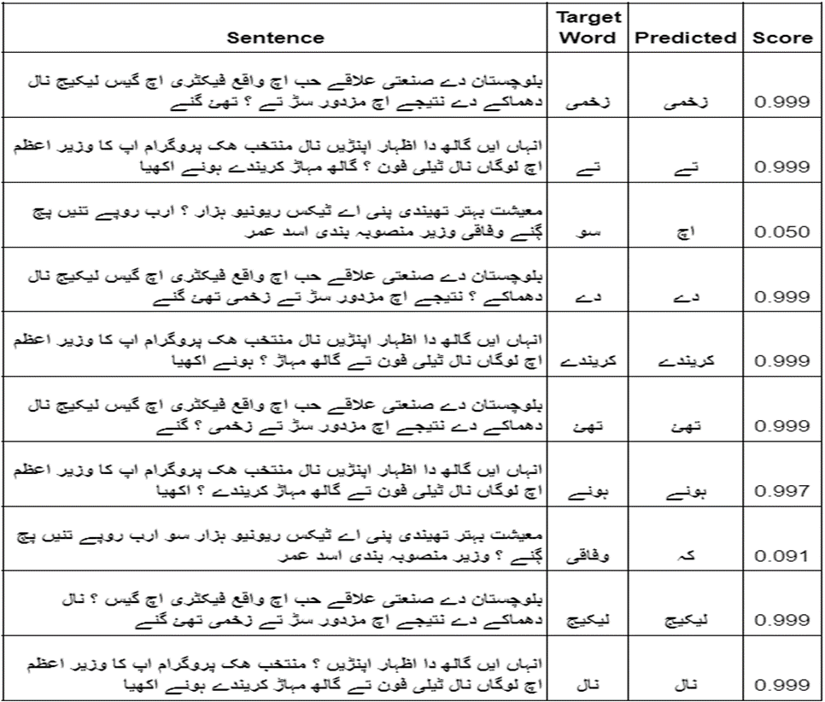
RoBERTa Word Prediction Results

Slide 28
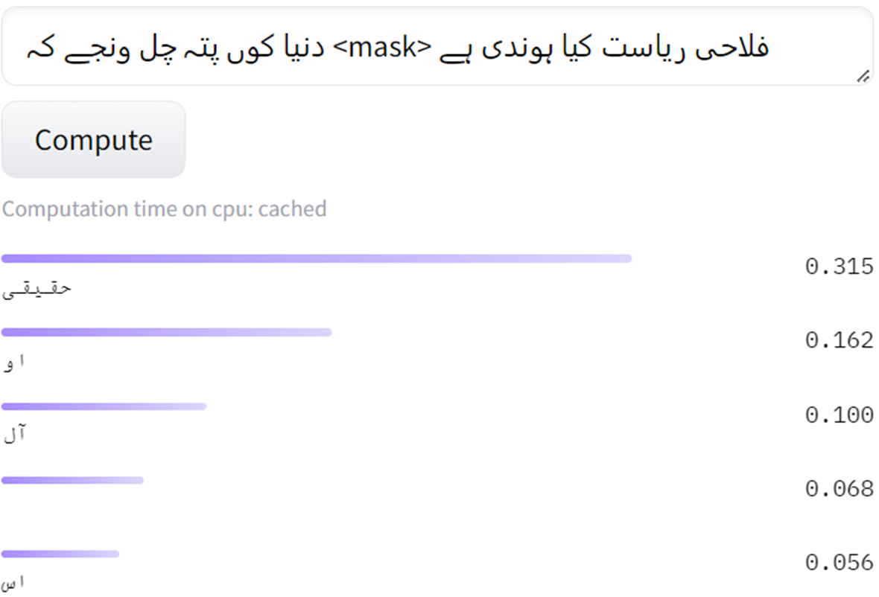
RoBERTa Results On Huggingface

Slide 29
RoBERTa Accuracy Results
Model | Perplexity | Accuracy
RoBERTa Base | 217.29 | 63%
Distilled RoBERTa | 234.12 | 58%
Notes:
Perplexity is inverse probability of the test set, normalized by the number of words

Slide 30
Conclusion
We have use Word2vec and Fasttext with different window sizes and vector sizes for word prediction and similarity task
We used Levenshtien distance for spell correction
Word2vec accuracy on word prediction task 24%
Fasttext accuracy on word prediction task is 29%
Number of Incorrect characters in word decreases accuracy of spell correction
Word prediction using RoBERTa base accuracy is 63% and distilled
accuracy is 58%
With vector size 768 word2vec word prediction accuracy is 20% and fastText accuracy is 18%

Slide 31
Future Work
We aim to collect more dataset to improve embeddings
Speech recognition is important task we want to build a model
that can recognize Saraiki speech
Part of Speech, NER taggers, sentiment analysis, text classification,
automatic video captions
Translation of Saraiki language is not listed in google translate

Slide 32
Any Questions !

Slide 33
Thank You ;-)

